Slide 1
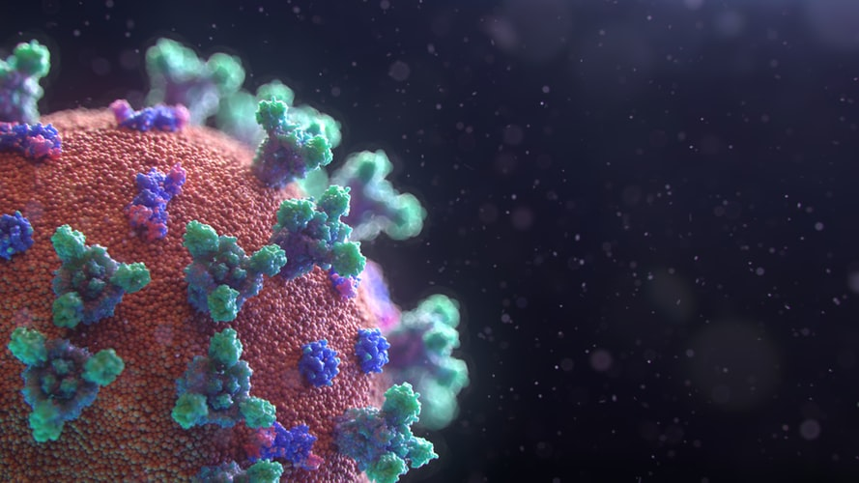

Masters Thesis Overview
AI-Powered COVID-19 Research Cockpit Presentation
Supplement – CORD-19 Initial Analysis (W.I.P.)
Jon-Paul Boyd
3rd September 2020

Slide 2











Pipeline From Development To Deployment
Goal help medical researchers find answers to their questions from literature, for example searching for better treatments & policy decisions. Interactive analysis of texts with data driven and NLP methods supported by AI techniques.
Raw Text
Preprocess
Framework
Model
Deploy
# Original Metadata Articles
237207*
# Original PMC Articles
72916
# Original PDF Articles
99336
Cleansing
Comparison titles/body text/abstract (PMC preferred as peer-reviewed)
Duplicate Articles
5
Documents Per Language
en 95796
de 1107
es 803
fr 652
it 351
95796 recs remaining after cleansing
* Difference indicates articles with abstracts only ☹
Unsupervised LDA (Latent Dirichlet Allocation)
Topic Modelling With Ktrain
* Other modelling approaches to be tested & benchmarked, including variety of LDA implementations & alternatives e.g. lda2vec
*
*
*
Serverless Backend
FaaS (Functions As A Service)
NoSQL Database
Web Server
* Estimated cloud costs (5K USD) total to May 2021 (TBC following further prototyping)
Metadata.csv
title, author, affiliations, publish date, links to full body text
PMC_JSON & PDF_JSON
full body text including abstract, results, conclusions
* Only PMC is peer-reviewed

Slide 3
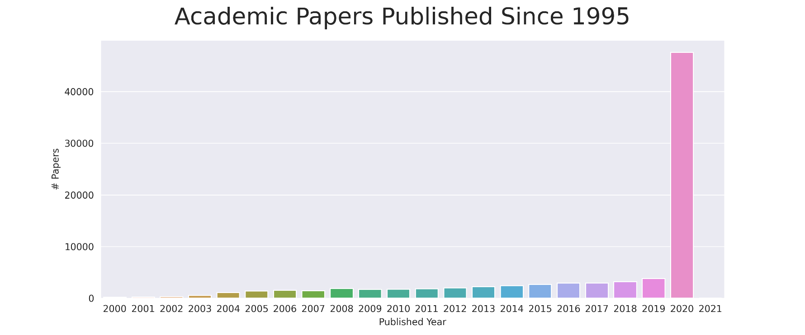

Data Analysis Coronavirus Publication Explosion & Word Significance
Number of coronavirus-related academic publications increased tremendously in 2020
Word cloud representing word frequency over 95K articles

Slide 4
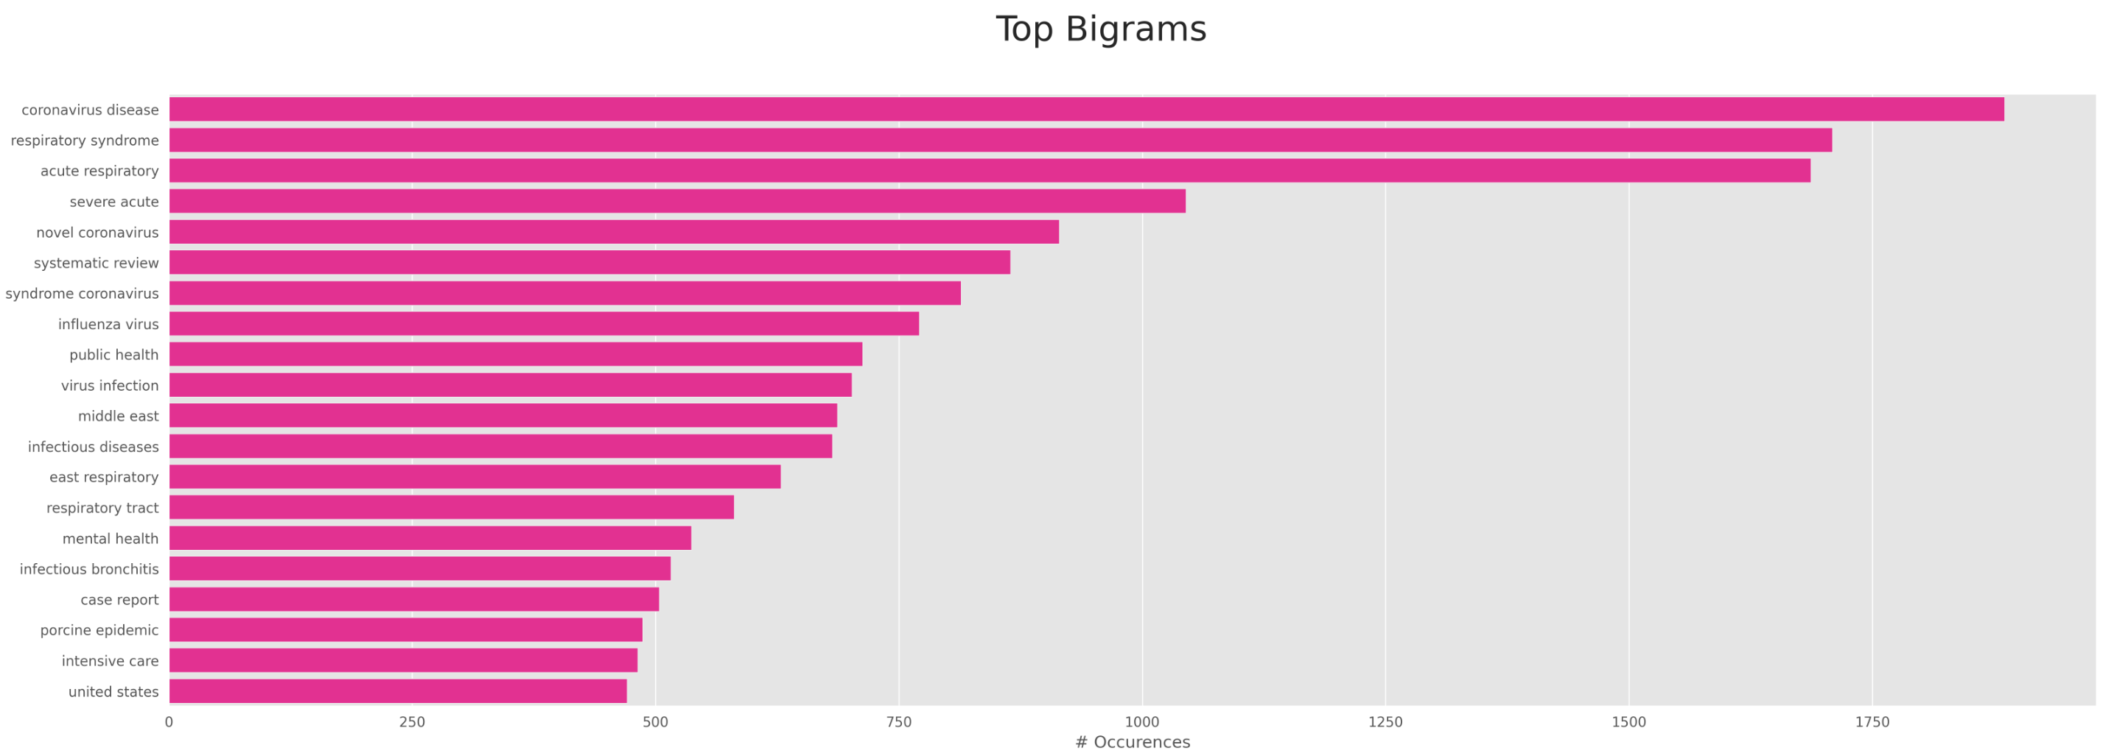
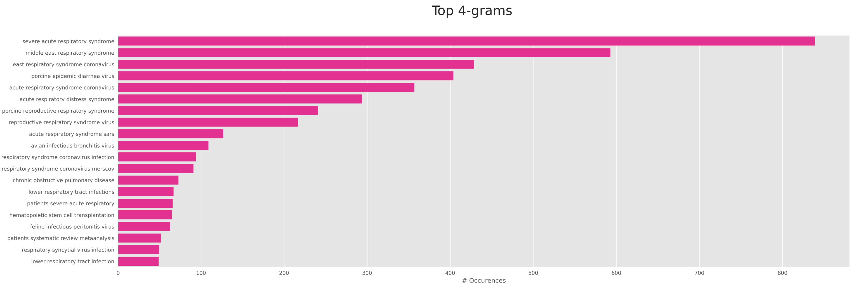
Data Analysis N-Gram Multiword Token Examples
Retain words appearing frequently enough together to include as complete entities.
Can be used for keyword token search, topic association, document categorisation & filtering.

Slide 5
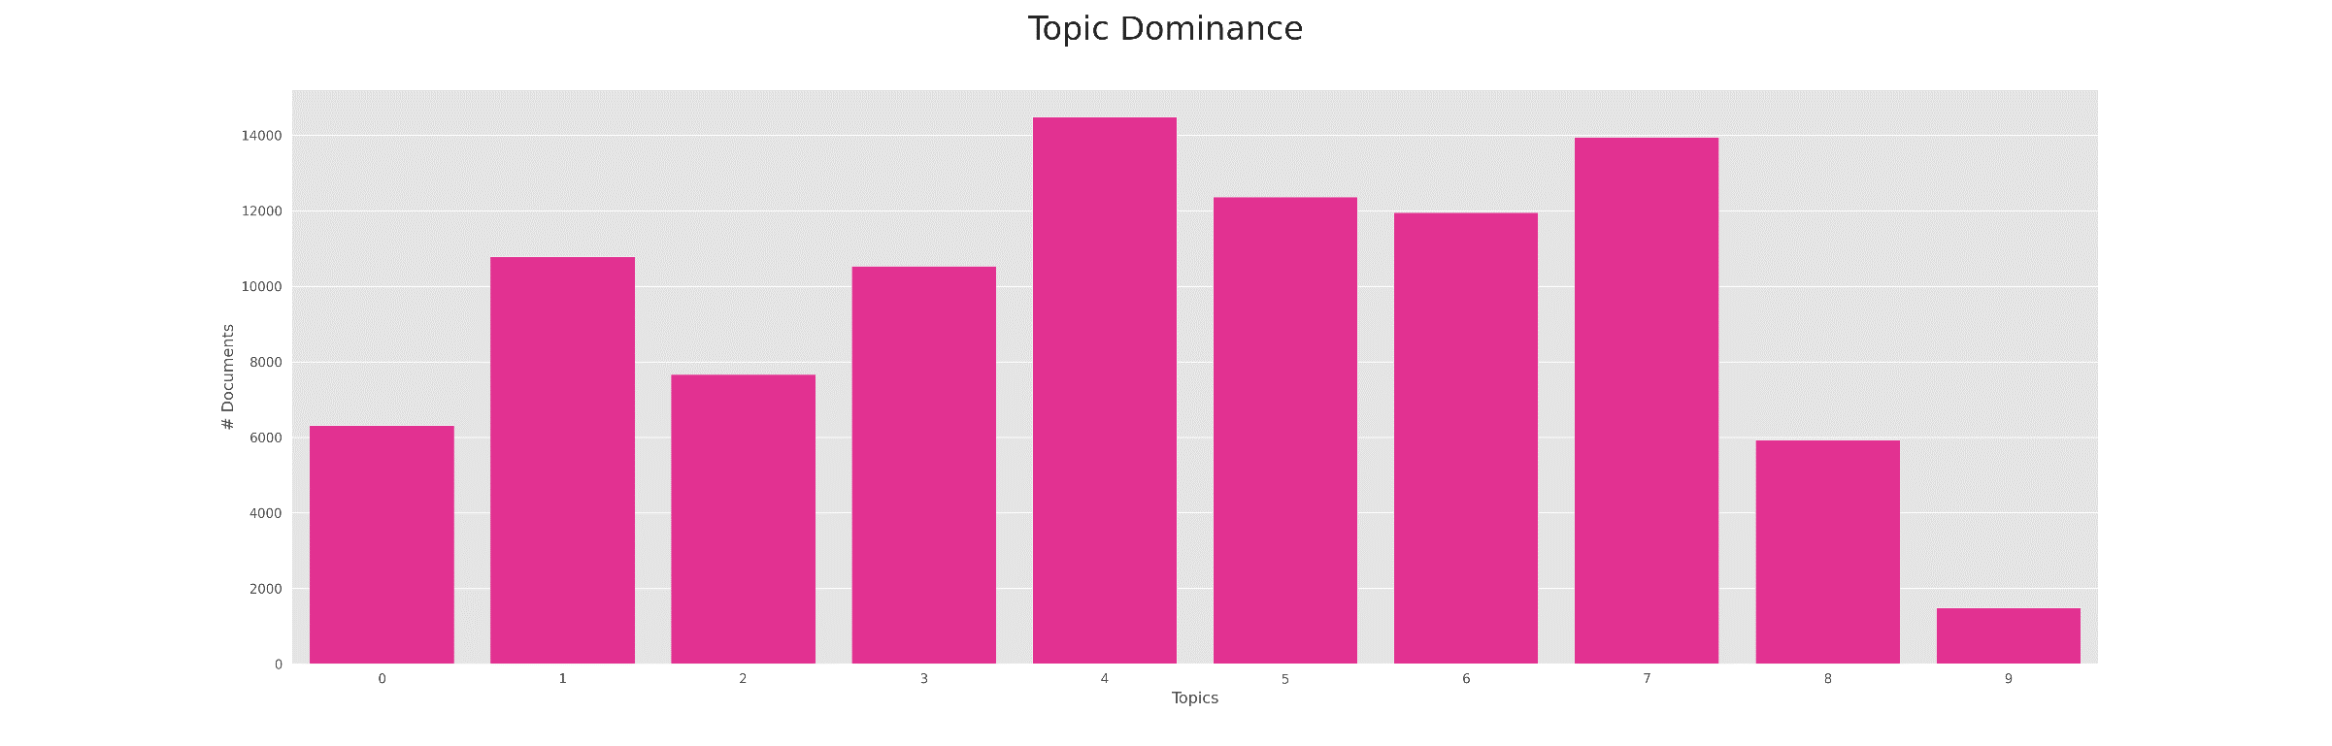
Topic Modelling Dominance *
Topic modelling is fully automated & extracts underlying semantic structure of documents to help shape their meaning. Each topic is a collection of words. Words belonging to topics have weights, so can be used to infer dominance & possibly a single subfield of study a given article can be associated with e.g. virology, immunology, genetics etc. Topic models can be trained on any problem domain corpus of text. Once trained, a TM can topic classify a new document without further training. In this example, training the TM took 37 minutes, processing 95K CORD-19 full article texts on a 6-core desktop CPU.
Topic 4
14483 docs
covid-19
children
symptoms
age
risk
sars-cov-2
pneumonia
group
days
mortality
Topic 7
13949 docs
research social
public
people information work countries global
risk development
Topic 5
12362 docs
protein
rna
proteins
fig
binding sequence activity
acid
dna
sequences
Topic 6
11946 docs
cells
cell expression mice
immune response protein
levels
fig
activation
Topic 1
10781 docs
care
covid-19 patient medical pandemic risk
hospital healthcare testing
staff
Topic 3
10534 docs
viruses samples vaccine species influenza strains animals infections detected infected
Topic 2
7661 docs
preprint covid-19 license medrxiv population model epidemic infected
doi
copyright
Topic 0
6314 docs
model models
fig
set
method network information values methods value
Topic 8
5924 docs
blood
group
patient therapy
lung
liver normal diagnosis cancer
years
Topic 9
1490 docs
use
package
document
end
begin
minimal
amssymb
amsfonts documentclass amsmath
amsbsy
* W.I.P. Additional stopword & lemmatization work required to remove & group words (e.g. remove fig, group cell/cells & protein/proteins). Also consider including n-grams e.g. blood group/liver cancer/lung cancer

Slide 6
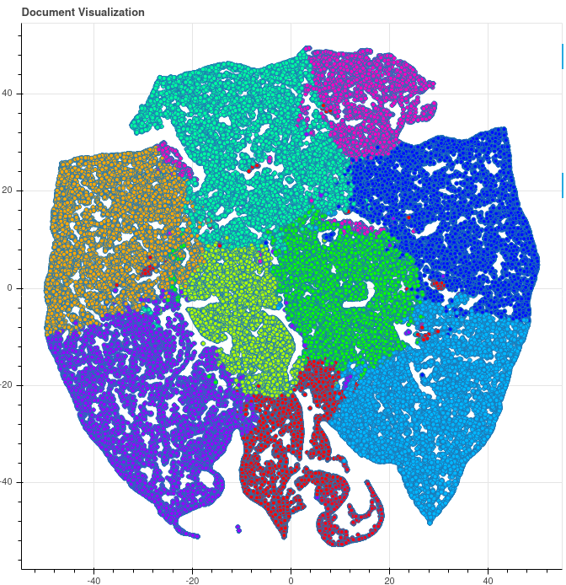
Topic Modelling Visualisation
PCA (Principal Component Analysis)
There are 10 topics. Each is represented by a different colour.
Each dot is a corpus document, coloured to indicate the assigned topic.
PCA reduces the 10-dimensional topic word vectors to 2 dimensions to support visualisation.
This dimensionality reduction facilitates measuring distance between document vectors, for example by using Euclidean geometry, to indicate a given document’s nearest neighbours, even if they belong to a different topic.
It means a search engine can enhance a query result hitlist by including additional neighbouring documents of a document included in search results, even if that neighbour does not include the query keywords e.g. include nearby red topic documents when orange topic documents rank highly in search results (grid ref x -30, y +5)
This helps support discovery and new insights.

Slide 7
Topic Modelling Recommender Example
Ktrain topic modelling also provides a recommendation engine that can recommend documents from the corpus that are semantically related to the question being asked. It surfaces scored documents from each topic with index allowing retrieval of original text.
Question
What do we know about therapeutics, interventions, and clinical studies?
Answer
--- Topic id 1 (care covid-19 patient medical pandemic risk hospital healthcare testing staff) Number of topic docs 10781 Most relevant document index 32074 Score 0.9737986869576298 Text: The source of infection is a person with SARS-CoV-2 infection. The number of patients attending healthcare facilities should be minimized by (1) advising persons with mild symptoms to be tested safely and then isolate, monitor their condition, and only seek in-person care if symptoms worsen; and (2) using telemedicine to provide care for patients whose medical needs can be addressed remotely. For
--- Topic id 3 (viruses samples vaccine species influenza strains animals infections detected infected) Number of topic docs 10534 Most relevant document index 79628 Score 0.981071403441446 Text: Wildlife diseases may represent a potential threat not only to local wildlife populations but also to domestic animals and humans. Various studies have been carried out to analyse the prevalence of pathogens in wild boar populations and the role of these populations as reservoir for pathogens or a source of infection for domestic pigs (Kaden et al. 2009). Wild boar (Sus scrofa) populations are fou

Slide 8
Further Thoughts
Q. How do you see the potential of NLP-based systems in helping your medical experts?
How successful are any of your current solutions in helping retrieve the right papers or answering questions correctly?
Q. What user experience are you looking for?
For example, a simple search bar with document retrieval ordered from most to least relevant? Or something further supported with information extraction and visualisation to explain ranking and generate insight? How important is including a snippet of text to directly answer the query?
Q. What unstructured data sources do you have access to?
Internal/external? Format? Volumes? Datasets available now? Licenses to academic publication servers? Do you extract from social media?
Q. Would you recommend including non-peer reviewed sources?
Should there be a weighting to prefer reviewed sources?
Q. How best to assess paper quality?
This is a tough problem that is also dangerous where using WHO trials, citations, social media critique could introduce bias. Thoughts?
Q. How should such NLP-based systems be measured for accuracy?
In typical classification & regression, performance evaluation is straight-forward by calculating loss from the ground truth. Given number of dimensions in unstructured text, how best to measure the effectiveness of a Q&A system? Manual evaluation requires experts and very time consuming? A golden ranking benchmark still requires manual assembly. Existing benchmarks (e.g. Stanford Question Answering Dataset, Machine Reading Comprehension Dataset, General Language Understanding Evaluation) relate to different, non-medical domains.
Q. What are your thoughts on a potential working relationship and how that might look? Expected deliverables going forward?

